Slide 1
Revision Record
Don’t Print This Page
COURSE CODE
PRODUCT
PRODUCT VERSION
COURSE VERSION
< COURSE CODE >
< PRODUCT NAME >
< VXXXRXXX >
1.01
DEVELOPER / MODIFIER
DATE
APPROVER
NEW / UPDATE
VIJAYASARATHY P. R.
20111012
NEW
Devidas
2012-01-30
UPDATE

Slide 2
Introduction to HUAWEI UAP3300

Slide 3

Target Audience
This course has been designed for audience who needs an introduction to HUAWEI’s UAP Platform which is an integral component of HUAWEI’s IPCC system.

Slide 4
Pre Requisites
Understanding of Basic telecom concepts.
Basic understanding of IP networking.

Slide 5

Objectives
This course would make the participants aware of the following topics from a contact centre perspective:
HUAWEI UAP3300 Platform
Different Boards of UAP3300 and their functions
Protocols supported by UAP3300
Scalability and Reliability of UAP3300

Slide 6

HUAWEI UAP INTRODUCTION
HUAWEI UAP3300 OVERVIEW
USPs
IMPLEMENTATION SCENARIOS
FREQUENTLY ASKED QUESTIONS

Slide 7
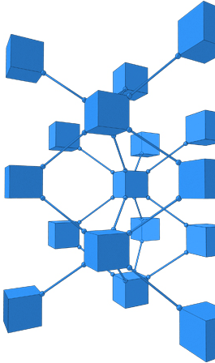
HUAWEI UAP Introduction
Core Components of HUAWEI IPCC
UAP Placement in IPCC Architecture
HUAWEI UAP
HUAWEI UAP Features at a Glance

Slide 8




Core Components of HUAWEI IPCC
HUAWEI’s IPCC solution’s core components are:
Universal Access Platform (UAP) which is its soft ACD
CTI Platform
IPCC
UAP
CTI Platform
Notes:
For CTI platform core components refer to Huawei CTI Basics_V1.0.ppt document.

Slide 9
HUAWEI UAP Features at a Glance
Access Gateway
PSTN/PLMN Network Connection
NGN Network Connection
Reduced space and power consumption.
Media Resource
Voice Announcement
Voice Record
Fax
Outbound Detection
TTS/ASR
UAP
Ensures system reliability.
Reduce maintenance workload and OPEX.
Call Control
Agent Phone Register
Call Connection

Slide 10
HUAWEI UAP INTRODUCTION
HUAWEI UAP3300 OVERVIEW
USPs
IMPLEMENTATION SCENARIOS
FREQUENTLY ASKED QUESTIONS

Slide 11
Introduction to HUAWEI UAP3300
UAP3300 Introduction
Protocols supported by UAP3300
Introduction to UAP3300 Boards
Reliability of UAP3300
Flexible Networking
Maintenance & Management

Slide 12
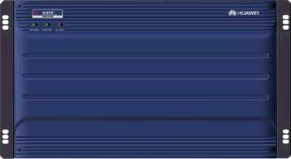
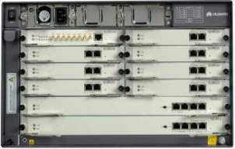
Introduction to UAP3300
The UAP3300 was developed by HUAWEI as a integrated narrowband and broadband access device to provide the following functions.
Media Access to the PSTN/PLMN and NGN
Media Resource for Announcement Playing, IVR Services, Fax Services and Voice Recording
Call Control including Call Admission and Call Distribution
Sip Registration for IP Phones/Soft phones of Agents
Outbound Tone Detection
Interface to external ASR and TTS Engines
Basic PBX Services
Front View
Rear View
Notes:
The outbound calls may land on Automatic Answering machines, Fax machines etc. UAP has the capability to identify the End user type( human or machine).

Slide 13
UAP3300 - S/W and H/W Specifications
Platform
DOPRA is a software platform which owns 6H features ( High usability, High reliability, High expansion ability, High openness ability, high load-balance ability. High real-time ability.)
OS
Adopts VXWORKS Operation System. Comparing Windows, Unix, or other public OS, VXWORKS is more secure and reliable.
Hardware
Based on HUAWEI mature hardware design experience. Adopts high capacity parts. Ensure hardware reliability.
Power System
Adopts 2+1 redundant power to ensure power supply security.

Slide 14
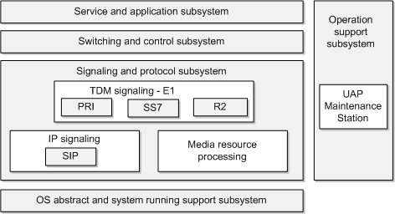
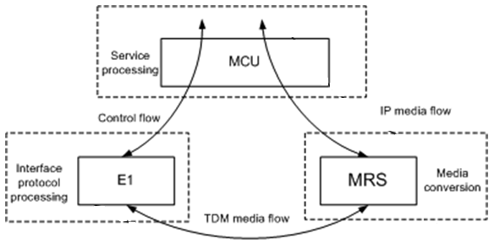
UAP3300 - Logical Architecture
Software Logical Architecture
Hardware Logical Architecture
Master Control Architecture
Modular Design
Separation of Control and Service Flows
The software of the UAP3300 adopts the top-to-bottom, layered, and modular design.
The UAP3300 consists of the service processing module, interface protocol processing module, and media conversion module.
For more details Refer UAP3300 Product Documentation
Notes:
Hardware Logical Architecture:
The UAP3300 consists of the service processing module, interface protocol processing module, and media conversion module.
Uplink TDM data flows are transmitted by interface boards to the MRS through the network chip on MCU. The DSP and CPU on MRS converts the flows into RTP packet.
Then L2 exchange chips on the MCU exchange the packets and send them to the external IP network.
The processing of downlink media flows is just the opposite.
Software Logical Architecture:
1. OS Abstract and System Running Support Subsystem
This subsystem:
Provides functions of abstracting the operating system (OS), such as
task scheduling, memory management, message management, event management, file system operations, and I/O operations.
Provides system support functions required for the running of programs, such as
the dynamic memory, timer, communication among modules and sub modules, and interfaces for debugging, tracing, diagnosing, and exception handling.
2. Signaling and Protocol Subsystem
This subsystem:
supports the PRI, R2, and SS7 signaling.
Through SIP that is based on IP,
this subsystem:
Retrieves signaling from the IP packets received by the system and sends the signaling to the IP network.
Complies with the protocol standards of the Request for Comments (RFC) and International Telecommunication Union (ITU-T) and achieves the protocol stack function.
Implements protocol adaptation with the service and application subsystem and the switching and control subsystem to provide services for media gateways or terminals that support related protocols.
3. Switching and Control Subsystem
This subsystem:
Controls media flows in the circuit switched (CS) domain and the packet switched (PS) domain, and between the CS domain and the PS domain.
Controls speech paths of the entire system.
In the traditional CS domain, this subsystem controls TDM network chips to implement circuit switching.
4. Service and Application Subsystem
Provides functions such as call locating, number analyzing, and trunk processing to control the entire call process.
Controls conferences, Manages network elements (NEs), registration of SIP users, and announcement playing.
5. Operation Support Subsystem
As the OM platform of the UAP3300, the UAP Maintenance Station of the operation support subsystem can perform remote maintenance on the host and devices of the UAP3300. The OMU shields users from implementation details of devices, which ensures that the maintenance personnel can maintain and manage the devices conveniently.
Uplink TDM data flows are transmitted by interface boards to the media resource Server( MRS) through the network chip on the main control unit (MCU). The digital signal processor (DSP) and central processing unit (CPU) on the MRS convert the flows into Real-time Transport Protocol (RTP) or Real-time Transport Control Protocol (RTCP) packets. Then the L2 (Layer 2) exchange chips on the MCU exchange the packets and send them to the external IP network. In the exchange process, the field programmable gate array (FPGA) in the MCU completes transformation of IP addresses. The processing of downlink media flows is just the opposite. For the downlink media flows, address translation is performed according to the types and port numbers of IP voice packets. Then the IP voice packets are exchanged to the corresponding MRS through the L2 exchange chips. After the MRS convert the IP voice packets into TDM data flows, the network chips on the MCU exchange the flows and send them to the ports of specified interface boards.
The uplink control flows, such as call control messages, are transmitted to the MCU through serial interfaces or the FE/GE interfaces. The MCU converts the received flows into flows based on SIP, and then translates addresses for the flows. After that, the flows are sent to the IP network. Downlink control flows are transmitted into the MCU through the IP interface of the MCU. After protocol resolution and processing in the MCU, the downlink flows are converted into messages of the PRI, R2, or other signaling and sent to interface boards.
The MCU uses the Power PC series processor, which has powerful processing capabilities. The MCU can:
Realize service functions such as call control, connection management, resource management, and user management.
Realize maintenance and statistic functions such as tracing, statistics, charging, alarm and command lines.
Process multiple protocols, such as SIP and PRI.
The Address Resolution Protocol (ARP) module embedded in the MCU constructs an ARP proxy in the system. The proxy is used to respond to ARP requests from MRS, EI, and other boards.

Slide 15
UAP3300 - Functions, Specifications, Capacity
Functions
Simple configuration
Specifications
Media Access
Media Resource
Call Control
Flexible networking
Height – 6U
2 Control Boards
8 service boards slots
Smooth Expansion
Carrier Grade Reliability
Capacity**
Narrowband Access
IVR:480 ports
or
Agents: 240 with recording enabled
Or
a combination of IVR and Agents
Broadband Access
IVR:720 ports
or
Agents: 360 with recording enabled
or
a combination of IVR and Agents
** The above figures are for a single UAP3300 frame. Up to 32 UAP can be stacked which will increase the capacity to 32 times the above values.

Slide 16
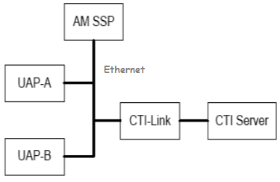
UAP3300 Stacking
Multiple UAP3300 can be stacked through the Administration Module (AM SSP) to increase the system capacity and share resources.
Functions of AM Tool
Capacity Expansion
Resource Sharing
Agent Routing Policy
Prefix Routing Policy
Remote O&M
Notes:
Capacity expansion and resource sharing
Resources (such as number of accessed calls, number of agents, and SS7 links) provided by a UAP3300 are limited; therefore, the resources cannot meet the requirements when the call traffic is too heavy. By stacking UAP3300s, you can increase the number of UAP3300s in the call center for capacity expansion and resource sharing. In addition, the system stability can be improved.
l Agent routing policy
After receiving a call, the UAP3300 routes the call to an optimal agent according to the call location, state of agents, and information about agents on the AM SSP.
l Prefix routing policy
When an agent makes a call, the UAP33000 (For example , UAP1) to which the agent is connected searches through AM SSP for an optimal UAP3300 (For example , UAP2) to process the call according to the outgoing prefix.
l Remote management and maintenance
The AM SSP consists of the AM SSP Client and AM SSP Server. The AM SSP Client is used to configure the AM SSP Server remotely. After configuring the AM SSP Server, you can submit the data directly instead of restarting the AM SSP Server to make the configured data effective. You can also view the partial status of the AM SSP Server through the AM SSP Client.

Slide 17
UAP3300 – PBX Functions
The UAP3300 is also capable of providing basic PBX functionalities.
Call Hold/Transfer
Call Forward
Sequent Ring
Synchronous Ring
PBX
Function
Call Line Identification
Speed Dialing
Call Back On Busy
Do Not Disturb

Slide 18
Introduction to HUAWEI UAP3300
UAP3300 Introduction
Protocols supported by UAP3300
Introduction to UAP3300 Boards
Reliability of UAP3300
Flexible Networking
Maintenance & Management

Slide 19



UAP3300 – Protocols Supported
The UAP3300 supports open and standard protocol interfaces. UAP3300 connects to external systems through these interfaces.
ASR
TTS
CTI
MRCP
MRCP
INTESS
ISUP/TUP/PRI/R2
SIP
NFS
File Server
NGN/IMS
SIP/RTP
UAP3300
Maintenance Tool
Agent Phone
TELNET/TFTP

Slide 20
Introduction to HUAWEI UAP3300
UAP3300 Introduction
Protocols supported by UAP3300
Introduction to UAP3300 Boards
Reliability of UAP3300
Flexible Networking
Maintenance & Management

Slide 21
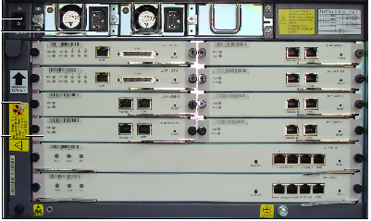
UAP3300 Boards
Slot 8
Slot 9
Slot 6
Slot 7
Slot 4
Slot 5
Slot 2
Slot 3
Slot 1
Slot 0
UAP3300 is made up of Control Board and Service Boards. It has a total of 10 slots (0 to 9) for these Boards.
MCU is the Control Board which occupies slot 0 and 1 (Active/Standby).
MRS and DTU are the Service Boards that can occupy Slots 2 to 9.

Slide 22

UAP3300 – MCU (Main Control Unit)
The UAP MCU is the Main Control Board of the UAP3300. It is primarily responsible for call admission and control.
Function
High Reliability
Flexible network
Network Access
System Upload
Signal/Call Process
Media Resource Management
Broadband And Narrowband Exchange
2 MCU boards-Active/Standby
Vxworks + Dopra
Online update
Over Load Protection
Congestion Management
One Interface is in charge of CTI Link Communication.
Another link is responsible for SIP/RTP communication.
The third interface is in charge of NFS/TTS/ASR communication.
Notes:
The UAP-MCU:
Processes media control protocols and supports the SIP, SIP-I (SIP with encapsulated ISUP), and SIP-T (SIP for Telephones) protocol.
Supports the single-network-port, dual-network-port, and triple-network-port work modes. Network port 1 supports the signaling and media flow data. Network port 2 supports the data flows of the NFS, TTS, and ASR.
Supports 1+1 hot backup.
When the active UAP-MCU fails, the standby UAP-MCU takes over services automatically.
Supports hot plugging.

Slide 23




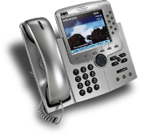



MCU - Separated Data streams, Ensure QOS
Each interface belong to different VLAN
Sudden Surge protection
Ensure Quality Of Service
Interface1
Interface2
Interface3
CTI data stream
Management data stream
SIP/RTP Stream
NFS/TTS/ASR Stream
CTI Platform
Agent Phone
File Server

Slide 24
UAP3300 – MRS (Media Resource Server)
The UAP MRS is a service board of the UAP3300. It is primarily responsible for providing the media resources required for Announcement playing, IVR functions and voice recording.
It is controlled by CTI platform and MCU
MRS Board Function
Announcement playing
Digit Collection
Voice recording
Fax ability（T30.T38)
TTS/ASR integration ability
Outbound detection ability
It connects to external network through MCU.
One UAP3300 supports a maximum of 6 MRS boards MRS boards work in load balancing mode.
Each MRS board provides 120 voice resources that can be used for IVR or voice recording or fax receiving and sending
MRS boards support hot plugging for seamless expansion
Notes:
The UAP-MRS connects to a file server to obtain voice files and store voice recording files. The UAP3300 configured with the UAP-MRS can replace the VP, CP and FP that consist of the industrial computer and the PCI E1 voice card. The UAP-MRS support hot plugging

Slide 25






MRS - Media process and Services
Supports voice playing format: 32kvox, 64kAlaw, 24kvox, 64kPCM.
Call Center Platform
File Server
Supports uploading ordinary voice file to cache to increase response time
MCU Board
Support DTMF and RFC2833
IP Exchange Unit
Supports conference based recording to record conversations and able to record in multiple formats
MRS Board
Digital Trunk Board
UAP3300 Internal Structure
TDM Exchange Unit
Integrates with TTS and ASR Engines through MRCP V2.0
CTI Data Stream
File transmittal stream
Voice media stream
Outbound Tone detection based on HUAWEI’s patented algorithm

Slide 26
UAP3300 – DTU (Digital Trunk Unit)
The UAP DTU is a service board of the UAP3300. It is primarily responsible for providing digital trunk interfaces for E1/T1 from the external network.
DTU Board Features
4 E1 termination
PRI Support
R2 Support
SS7 Support (ISUP, TUP)
Hot plugging
DTU Boards work in load sharing mode to avoid single point of failure.
Notes:
With four E1 interfaces, the UAP-4DTU:
Connects to the PSTN through E1 cables to connect to digital trunks such as PRA trunks and CNo.1 trunks.
Connects to PCI E1 voice cards through E1 cables and E1 transfer boxes to connect to resource peripherals such as the VP, CP, and FP.
Supports hot plugging. The UAP-4DTU needs to be inserted two seconds later after being

Slide 27
Introduction to HUAWEI UAP3300
UAP3300 Introduction
Protocols supported by UAP3300
Introduction to UAP3300 Boards
Reliability of UAP3300
Flexible Networking
Maintenance & Management

Slide 28
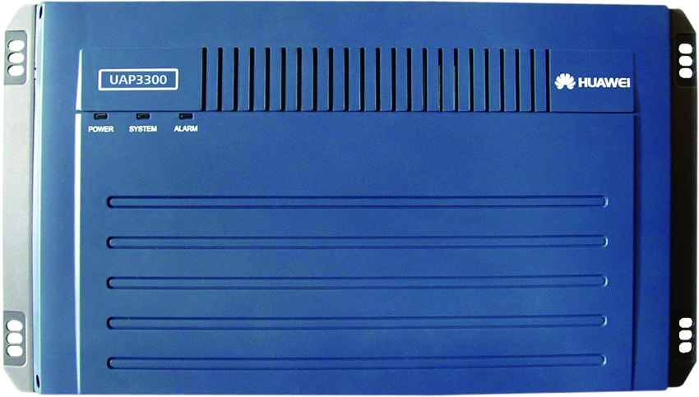
Reliability of UAP3300
The UAP3300 is designed to have high availability. Critical boards such as MCU work in active standby mode and service boards (MRS and DTU) work in load sharing mode to avoid single point of failure.
UAP3300
MCU Boards work in Active Standby Mode
MCU
MCU
MRS
MRS
MRS and DTU Boards work in Load Sharing Mode
DTU
DTU

Slide 29

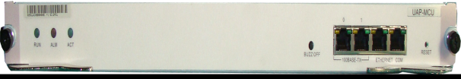

UAP3300 – MCU Reliability
Internal heart beat
Data synchronization
Main MCU
Backup MCU
Trunk
LAN Switch
LAN Switch
Backup MCU detects the failure and changes to active status.
Main MCU or LAN Switch connected to main MCU fails
Notes:
When both the MCU slots are installed with MCUs, the system runs in active/standby control mode and has higher reliability. When the active UAP-MCU fails, the standby UAP-MCU takes over services automatically.

Slide 30


UAP3300 – Local Survivability
CTI Server-1
CTI Server-2
Main CTI-LINK
Backup CTI-LINK
CTI Server-1 is the default CTI Server.
Once CTI Server-1 is down, UAP will choose CTI Server-2.
Agent management
Security Guarantee
In case CTI Server-1 and CTI Server-2 are both down, UAP3300 supports agent management function.
UAP3300 supports simple ACD function.
Main CTI LINK
Backup CTI LINK
Three mechanisms ensure service reliability.
UAP3300
Notes:
When Active & Standby CTI fail, the UAP ensures call routing to the Agent phones, thus ensuring Survivability during full system failure.

Slide 31
Introduction to HUAWEI UAP3300
UAP3300 Introduction
Protocols supported by UAP3300
Introduction to UAP3300 Boards
Reliability of UAP3300
Flexible Networking
Maintenance & Management

Slide 32

Centralized Network Structure
Headquarters
CTI
Platform
AM Server
UAP3300 supports stacking for smooth expansion.
PSTN links are load balanced. This can ensure the connection reliability.
UAP3300 Stack
It is convenient for maintenance and management.
AM Server will be used to configure and maintain UAPs
Notes:
In the centralized networking, the trunk access device, CTI platform, IVR, resource peripheral, agents, database, and file server are deployed on a centralized basis and are isolated from external networks. This networking mode can reduce OM cost and risks from network attacks.
The centralized networking is applicable to the call center with no branch.
All the UAPs are connected to the CTI at centralized location.

Slide 33




Distributed Network Structure
Headquarters
Reduced bandwidth occupation.
Increased reliability
Local agents provide local service
Increased service quality and customer satisfaction.
CTI Platform controls all the UAP distributed at each locations.
UAP3300 distributed at each location provides local voice playing, local voice recording, and local agent function.
CTI
Platform
AM Server
UAP3300
UAP3300
Control Signal Stream
Voice media stream
Branch 1
Branch 2
AM Server will be used to configure and maintain UAPs
Notes:
In the distributed networking, all the call connections of branch nodes are processed on the CTI platform at the headquarters, and all the devices of branch nodes are managed uniformly through the management terminal. The UAP3300 of each node provides the local regeneration function. If a node is disconnected from the IP network of the headquarters, the local regeneration function is enabled to ensure that the basic services of the node are not interrupted.
In Distributed Networking, the UAPs at local branches handle the voice media stream function.

Slide 34
Introduction to HUAWEI UAP3300
UAP3300 Introduction
Protocols supported by UAP3300
Introduction to UAP3300 Boards
Reliability of UAP3300
Flexible Networking
Maintenance & Management

Slide 35
UAP Maintenance Station
UAP Maintenance Station is a centralized tool to maintain and monitor all UAP3300 in a network.
Alarm
Alarm Set-up and Clearance Suggestions
Configure
Remote implementation, upgrade, rollback, expansion, configuration modification hot patch management.
Monitor
Remote monitoring of the UAP3300, including status monitoring of boards, CPU, E1 links, Channels, TTS, Trunk links, component connection and SIP terminals.
Trace
Enable the signal tracing of SIP, SS7, PRA and INtess protocol
Log Server
Service interaction logs, resources, trunk-related logs, and disconnection statistics.
Notes:
The UAP Maintenance Station is a feature of HUAWEI’s IPCC solution that provides users with a single interface to maintain and manage the UAP3300 in the network. It provides a host of features such as alarm setting, enabling trace, monitor and configure UAP3300 as well as providing the interface to integrate with HUAWEI’s Network Management System.
The UAP Maintenance Station adopts the client/server (C/S) architecture. One server maps multiple clients, and multiple clients can simultaneously configure, monitor, and trace the data in multiple areas.
Server : The UAP Maintenance Station server is the core of the tool, which interacts with the UAP and handles the requests of UAP Maintenance Station clients. When a UAP Maintenance Station client submits the configuration data, the UAP Maintenance Station server analyzes the data, generates UAP commands, then delivers the command to the UAP, and saves the configuration command on the local server.
Client: The UAP Maintenance Station client implements the communications and interaction with the UAP Maintenance Station server

Slide 36
HUAWEI UAP INTRODUCTION
HUAWEI UAP3300 OVERVIEW
USPs
IMPLEMENTATION SCENARIOS
FREQUENTLY ASKED QUESTIONS

Slide 37
USPs
UAP is derived from core network product line (SoftX3000), thus it naturally inherits all stringent parameters of a Carrier Grade switch.
Future Proof High Grade ACD device supporting both broadband (NGN, 3G), narrowband interfaces (TDM) and Multimedia.
Support to PSTN, GSM, CDMA, NGN, IMS networks at the same time
UAP can support high capacity BHCA, reliability: 99.999%
Automatic overload and congestion controls
Dual-homing, fault-tolerance and disaster recovery solution
Reliability has been ensured at hardware and software level
Support abundant protocols SIP, ISUP, TUP, BICC protocol etc. IMS ready.
FAX supports both T.38 & T.30.
High Capacity with BHCA of 12000K and reliability of 99.9999%.

Slide 38
HUAWEI UAP INTRODUCTION
HUAWEI UAP3300 OVERVIEW
USPs
IMPLEMENTATION SCENARIOS
FREQUENTLY ASKED QUESTIONS

Slide 39
Implementation Scenarios
Requirement 1: A Bank wishes to setup a centralized contact centre with branches in 4 different location of the country offering services in regional languages. The Bank wishes to route calls between different UAPs depending on the customer’s preferred language. How can this be achieved in UAP 3300?
Solution: The Bank can have a centralized contact centre containing the complete installation of IPCC. The regional sites can have UAP 3300 with a local File Server. The routing of calls between different UAPs can be controlled using Administration Module(AM).
Headquarters
CTI
Platform
AM Server
UAP3300
UAP3300
UAP3300
UAP3300
Branch 1
Branch 2
Branch 3
Branch 4

Slide 40
Implementation Scenarios…
Requirement 2: A Retail Chain is planning to launch a small contact centre with 120 Trunk(E1) Lines, 60 IVR ports and 60 agents. What would be the composition of the UAP 3300?
Solution: The UAP 3300 would have the following composition:
2 Nos - MCU Board
1 Nos – 4DTU Board (4 DTU =120 E1 Trunks )
(480 Voice channes = IVR =480 or Agents= 240)
2 Nos – MRS Board(MRS= 120*2 = 240 voice channels)
Requirement 3: A BPO wishes to setup a contact centre with analog end points for the agents which would be responsible for signaling conversion between IP to TDM. Which Board in UAP 3300 would interface to the IAD(Integrated Access Device) to achieve this?
Solution: MRS Board.
Notes:
UAP 3300-Narrow Band
4 Mrs and 4 DTU.
1 DTU =120 voice channels so 4 DTU =480 voice channels. IVR =480 and Agents= 240.
UAP 3300-Broadband
6 MRS
1 MRS supports 120 voice channels.
6 MRS= 120 *6= 720 voice channels.
IVR =720 and Agents =320.
UAP supports maximum of 6 MRS boards.
1DTU =4 trunks
Agent requires san additional channel compared to IVR for recording purpose.

Slide 41
HUAWEI UAP INTRODUCTION
HUAWEI UAP3300 OVERVIEW
USPs
IMPLEMENTATION SCENARIOS
FREQUENTLY ASKED QUESTIONS

Slide 42
Frequently Asked Questions
Q1. How many UAP 3300s can be stacked ?
32 UAP 3300s can be stacked using Administrator Modules (AM).
Q2. Can UAP 3300 support video calls ?
No, UAP 3300 does not support video calls.
Q3. What is a universal slot ?
In UAP 3300 slots 0 and 1 are used to accommodate MCU boards only and other eight slots (2 – 9) can accommodate any other boards like MRS,DTU,ATU etc and are called universal slots.
Q3. To how many CTIs can a UAP 3300 connect to ?
A UAP 3300 can connect to 2 CTI servers, where one will be master and another will be slave.

Slide 43
Frequently Asked Questions
Q5. What are UAP3300 functions?
Media Access to PSTN/PLMN/NGN
Media Resource Platform
Control and ACD
Q6. What are the boards in UAP3300?
MCU – Main Control Board
MRS – Media Resource Server
DTU – Digital Trunk Unit
Q7. What is UAP Reliability design?
Core Boards (MCU) work in Active Standby Mode
Service Boards (MRS and DTU) work in Load Sharing Mode

Slide 44
Reference Materials
UAP3300 Product Description
http://support.huawei.com/support/DocView.do?doc_id=SE0000497548&doc_type=ProductManual-soft

Slide 45
Thank You
www.huawei.com

